Slide 1
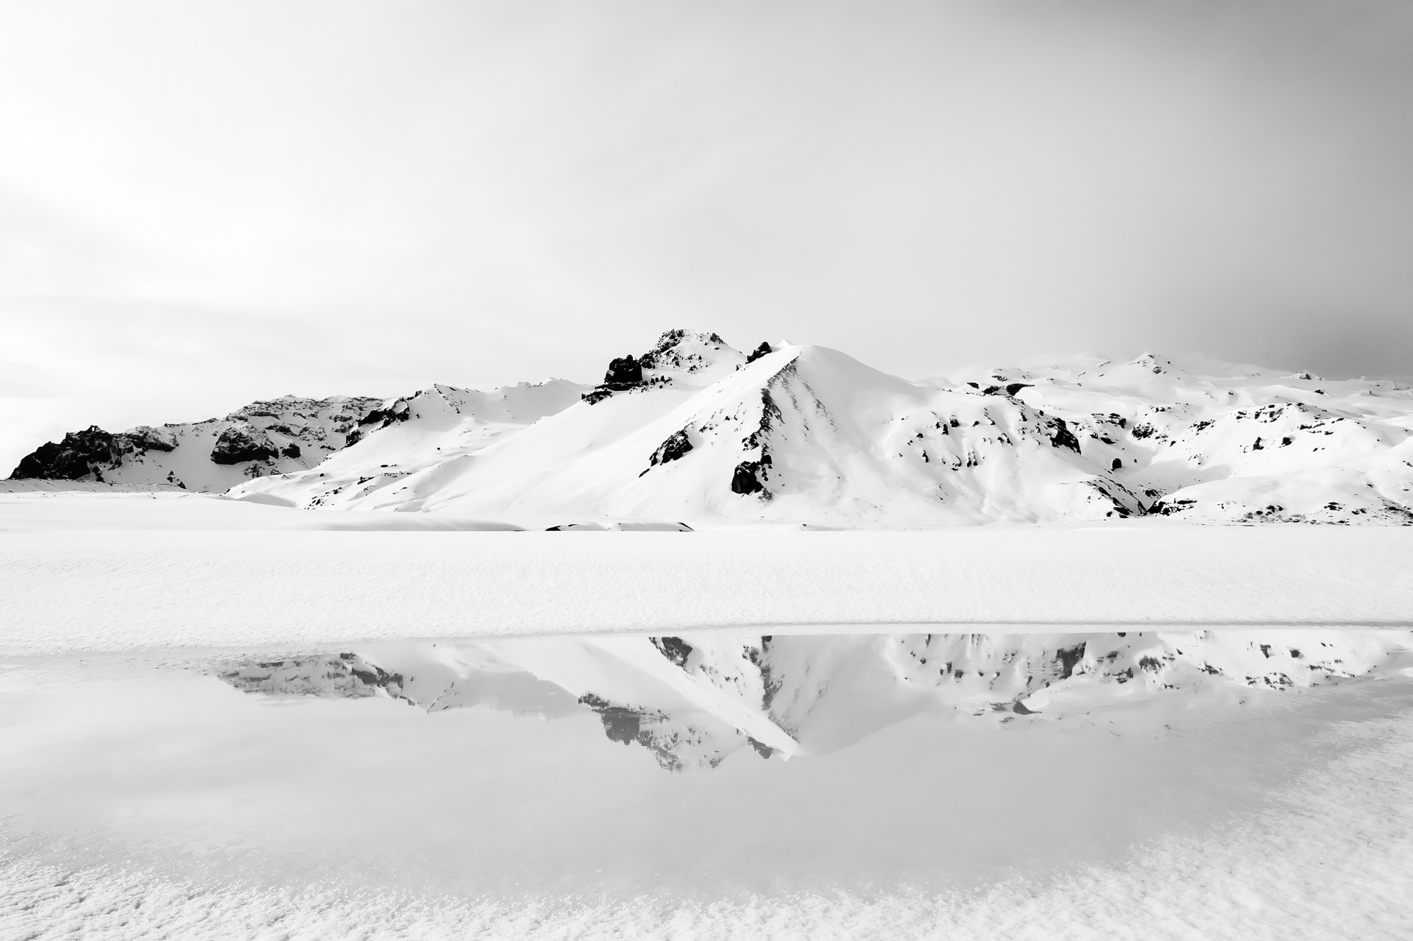
Classifying Photos Using Deep Learning Techniques

Slide 2
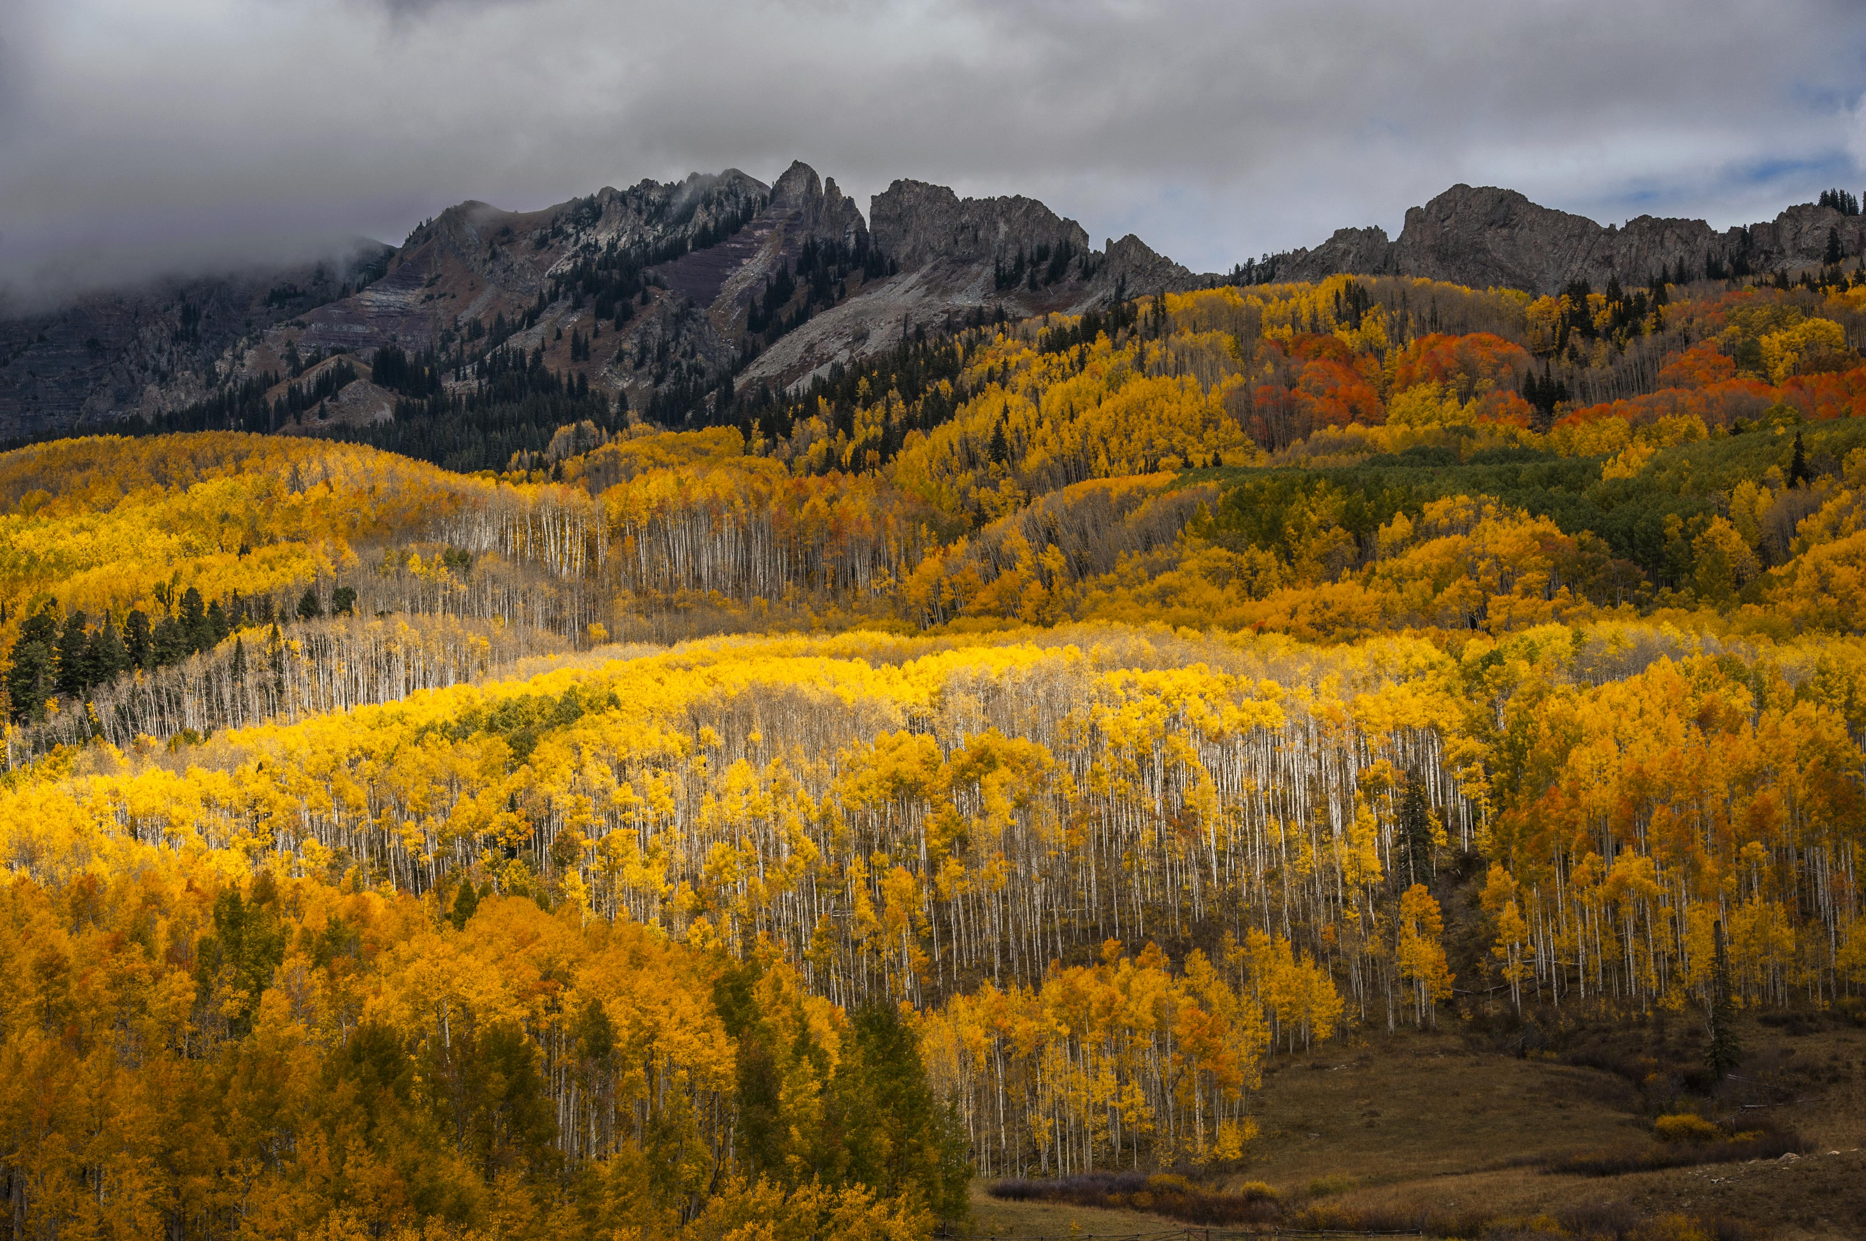
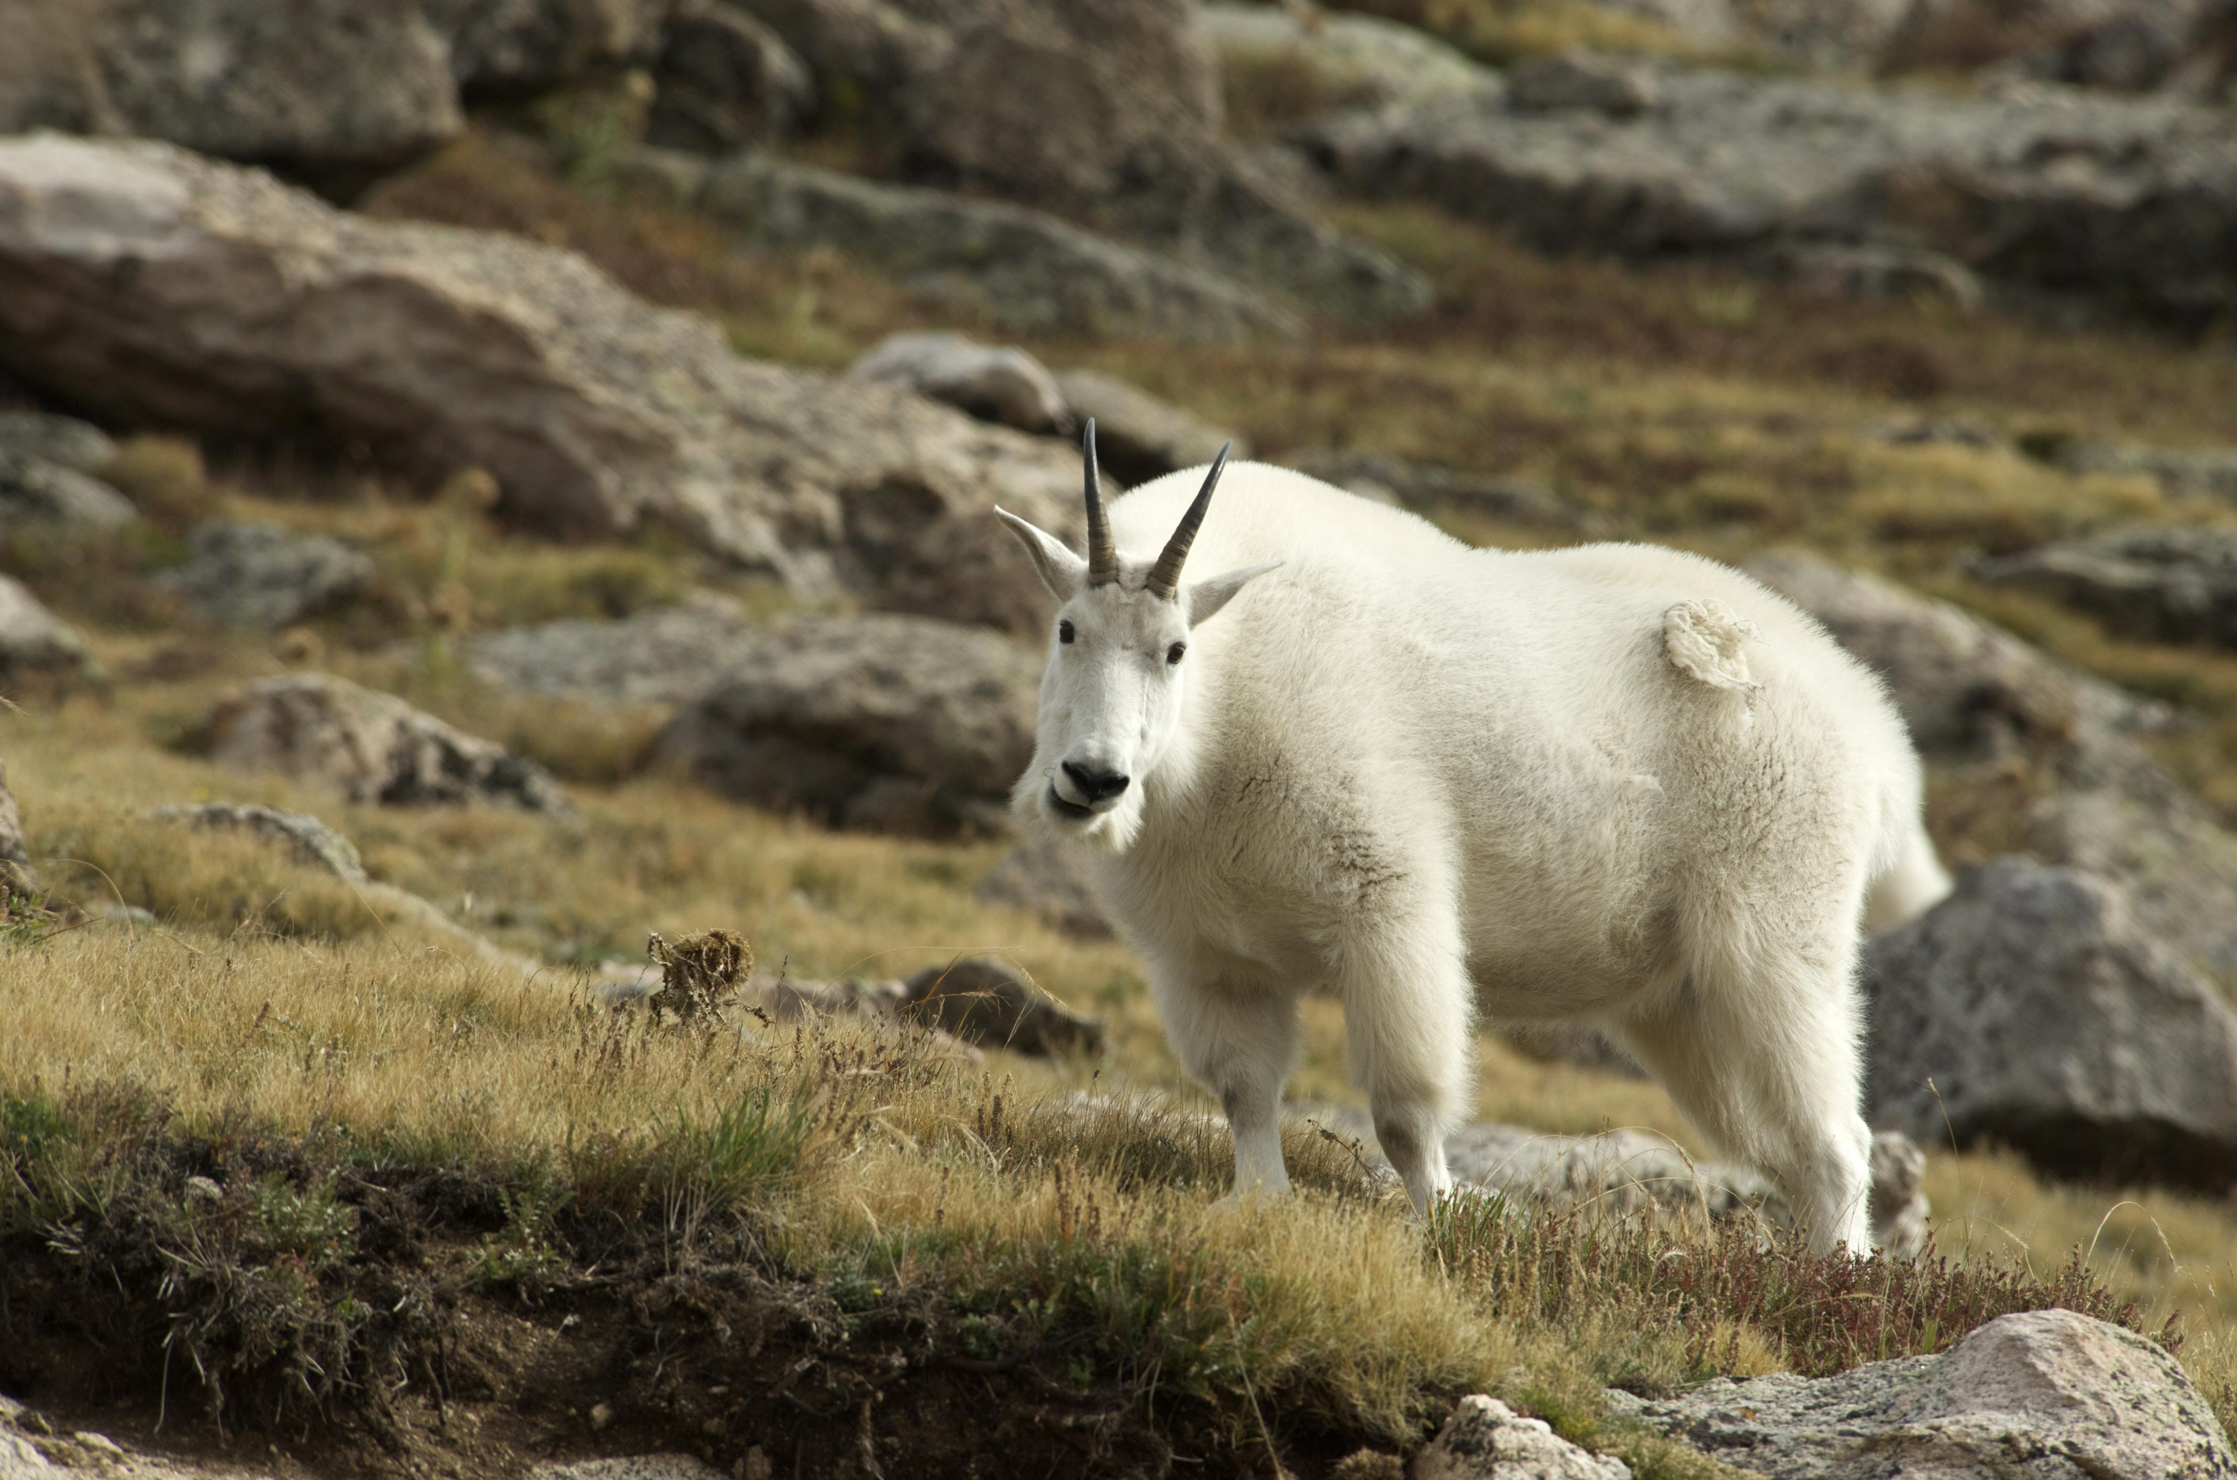
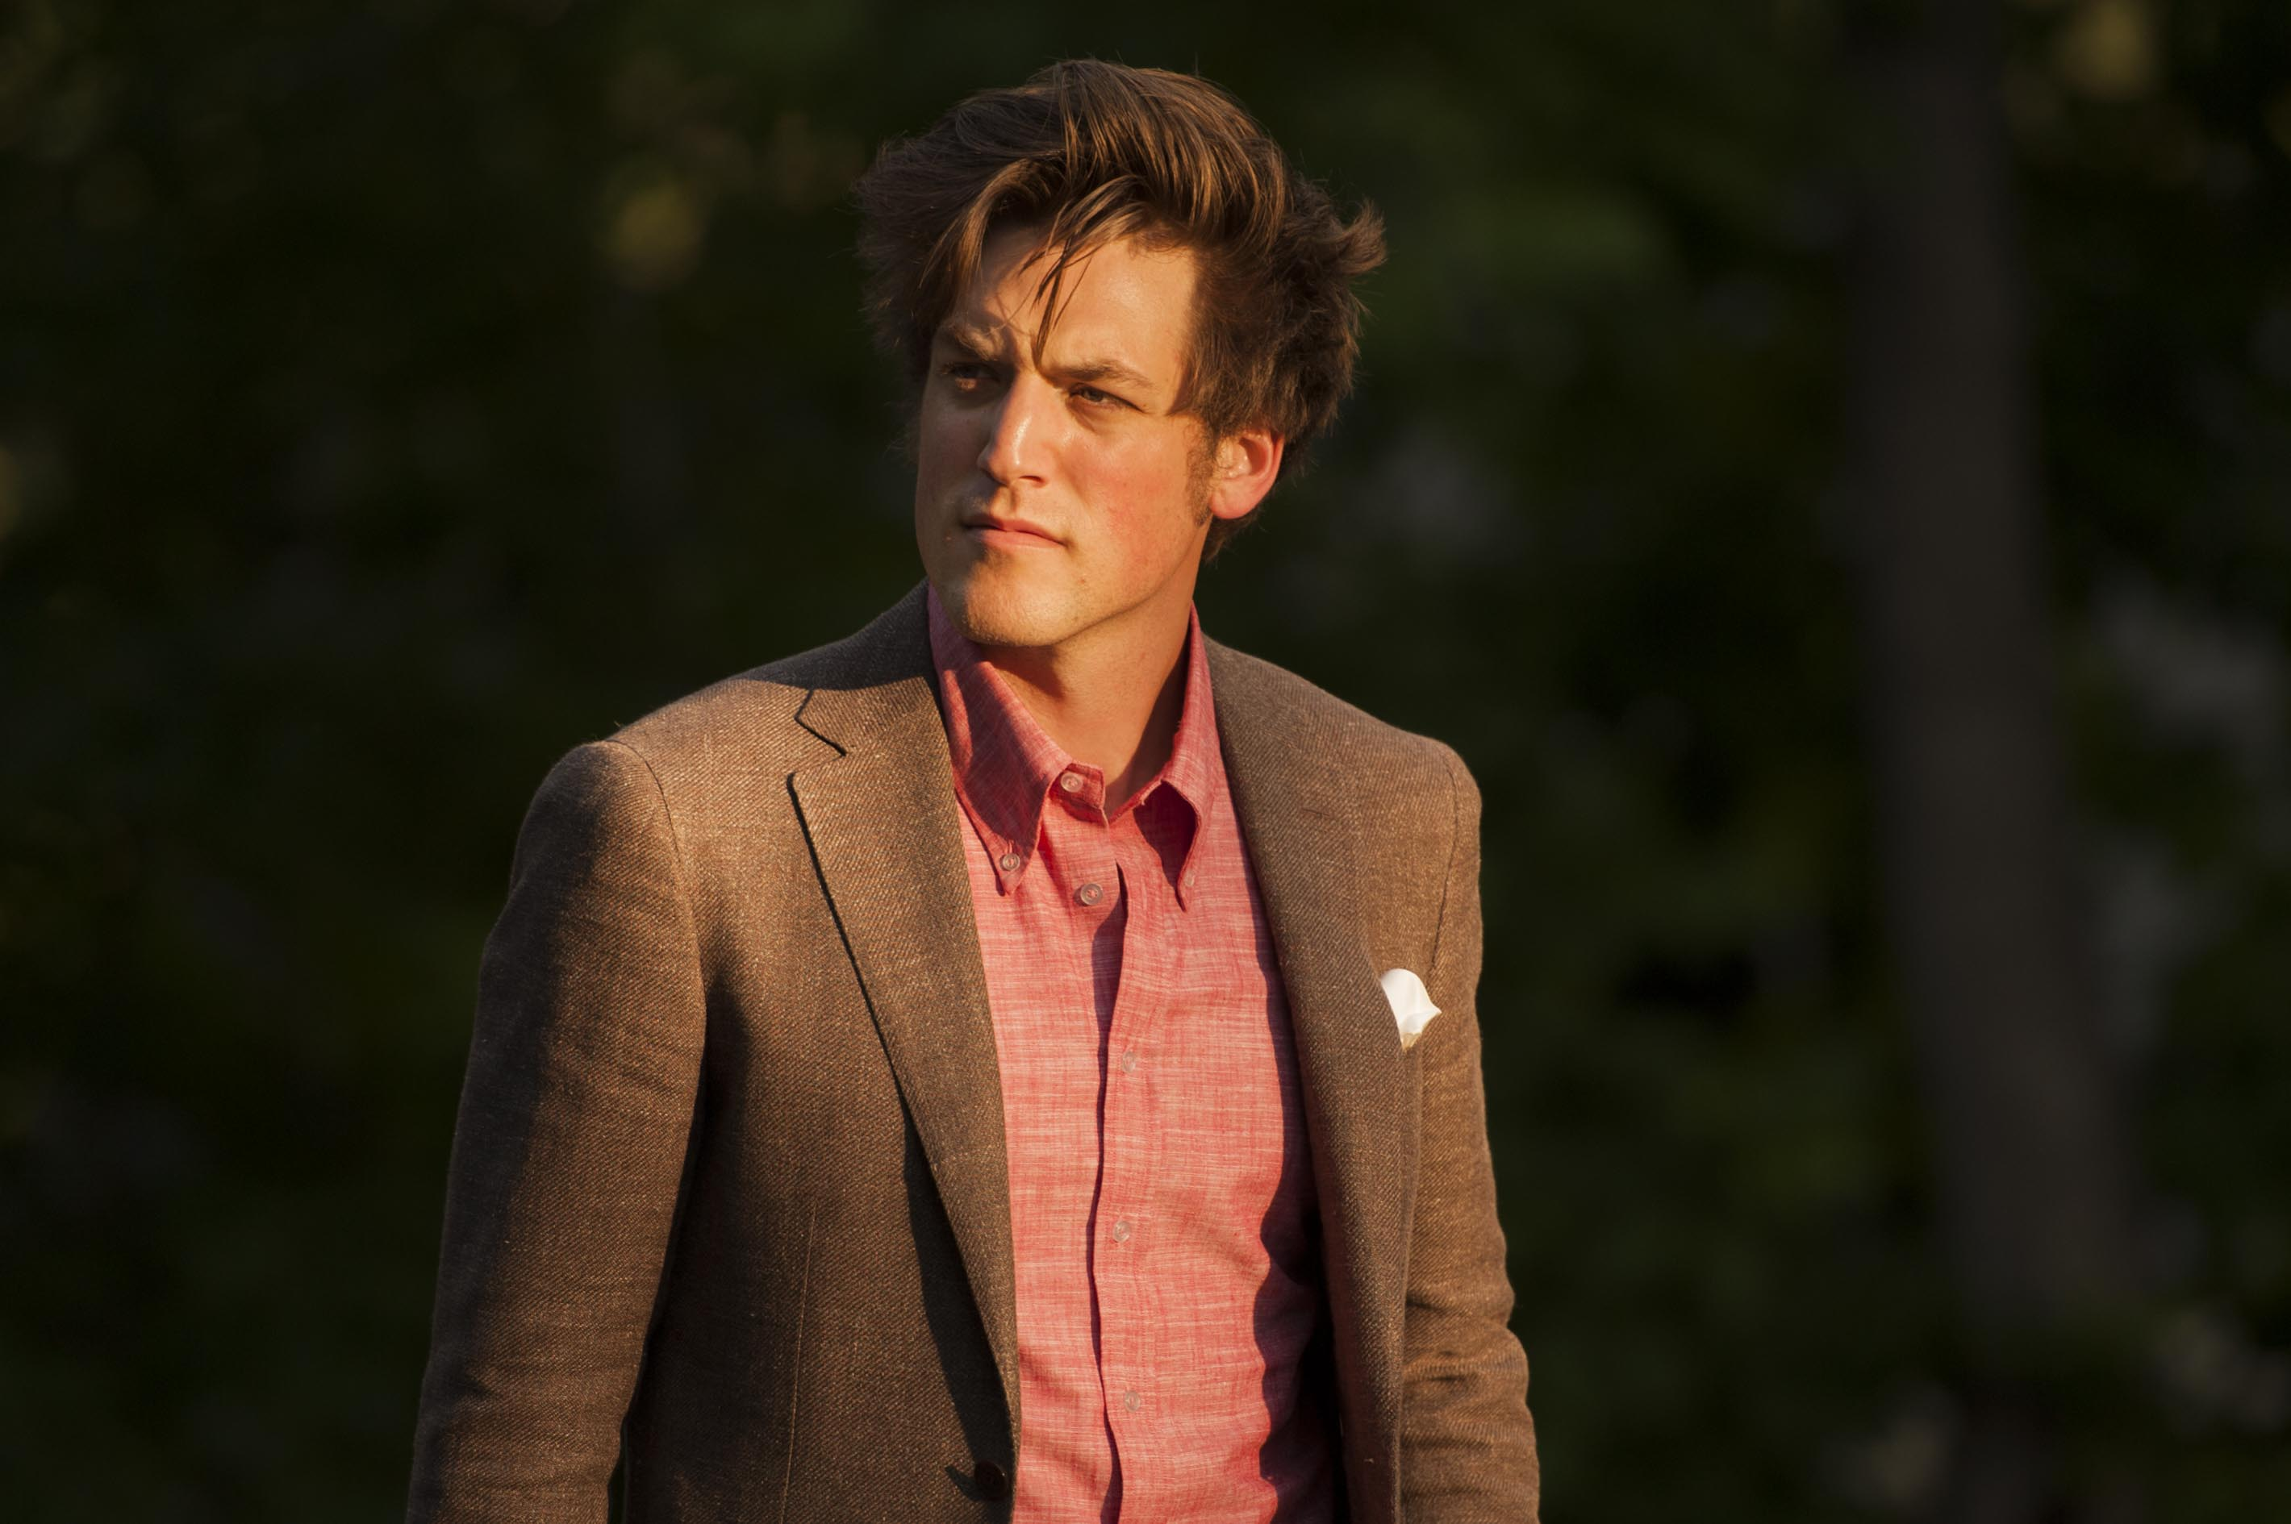
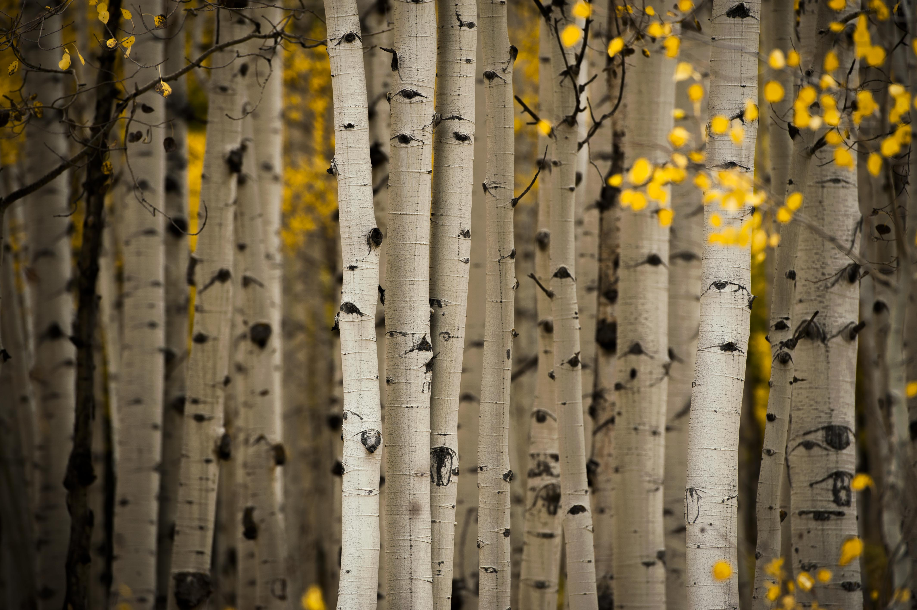
Problem and Client
Predicting the category of photographs
Landscape, people, plants, animals
200 images in each category
640 training images
160 validation images
Stock Photography Site
Use to classify new images automatically
Individual Photographers
Use to tag photos, potentially too many to do by hand

Slide 3
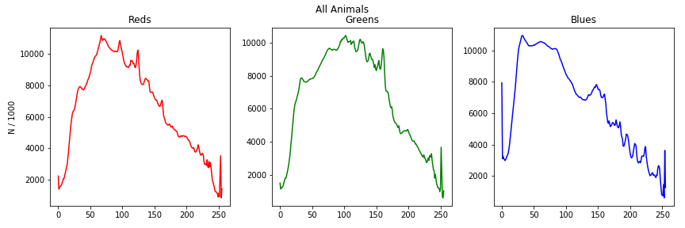
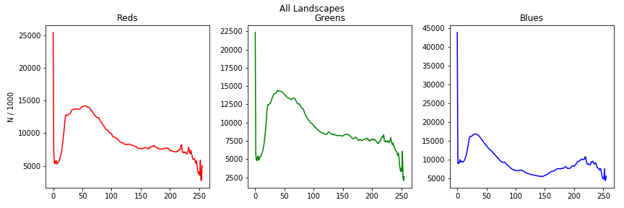
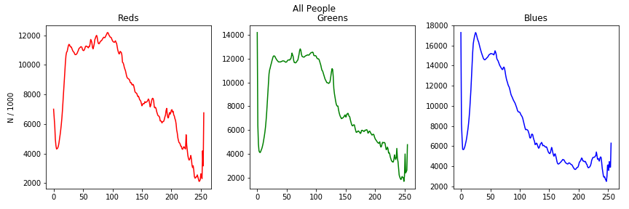
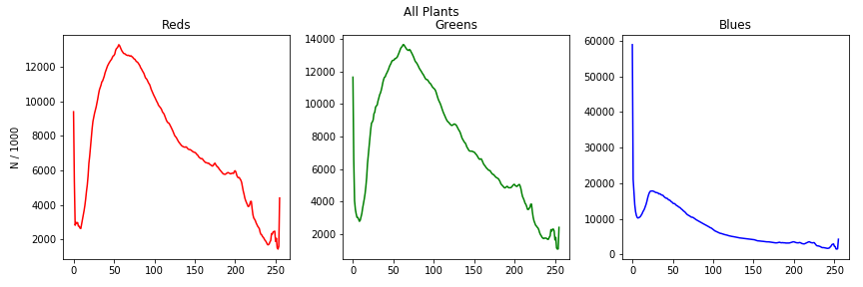
Color Channel Values
Frequency of color channel values for each category
X-axis represents less to more influence of a color

Slide 4
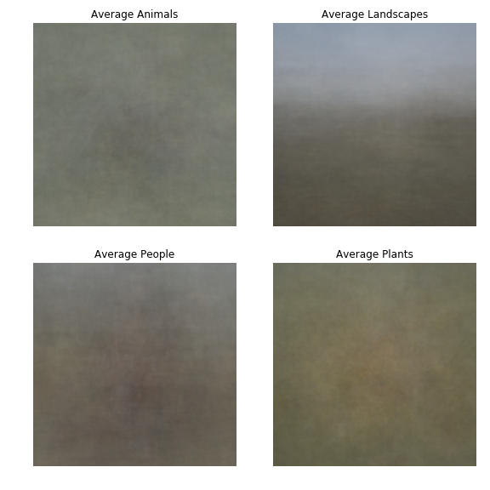
Average Images
Resized images to 256 on short side
Took 224x224 center crop
Divided each image by 200, added that to empty array

Slide 5
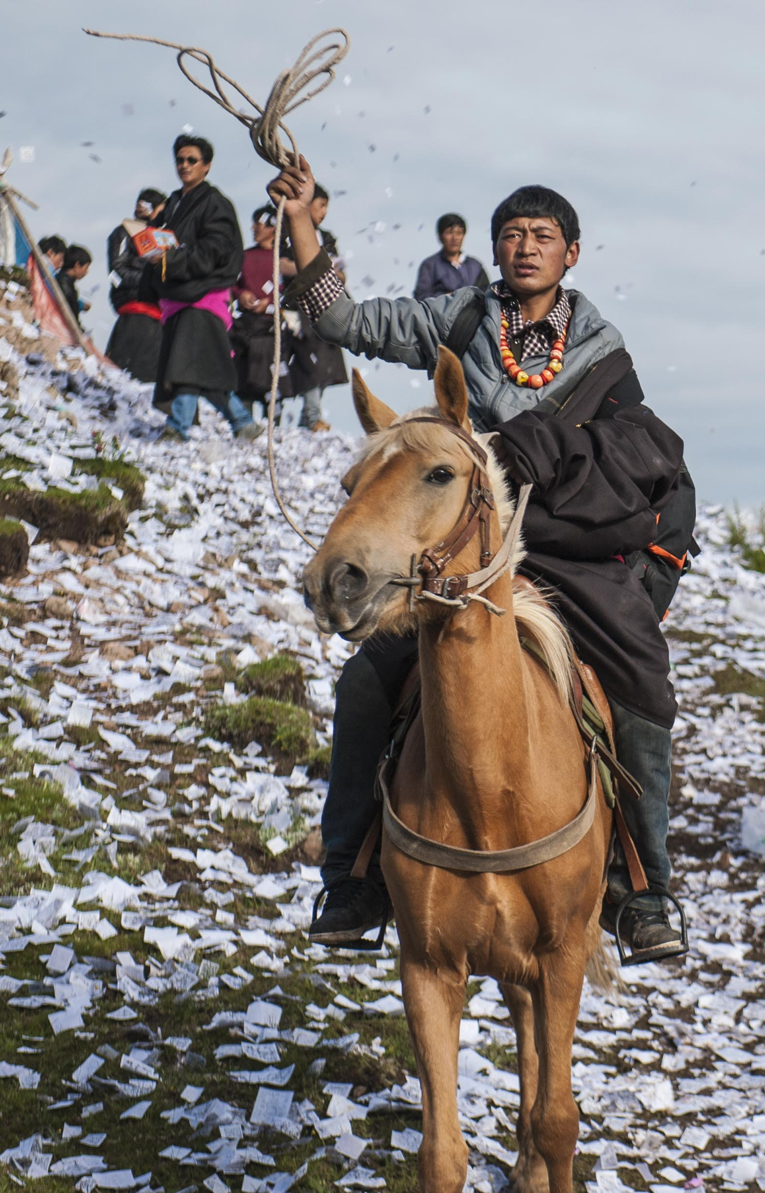
Models Tested
Logistic Regression
Feed-forward Neural Net
2-layer
Sigmoid activation function
Simple CNN
2-layer
64 output channels, 7x7 Kernel, stride = 1, same padding
128 output channels, 5x5 kernel, stride = 1, same padding
ReLU activation
ResNet101
Transfer Learning
Re-train all parameters

Slide 6
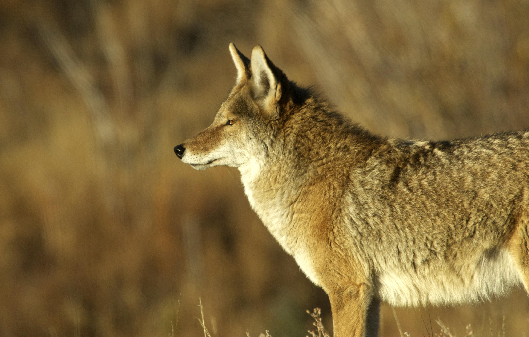
Image Transformations
Crop
LogReg, FNN, CNN resize to 256, 224x224 center crop
ResNet RandomResizedCrop, 224x224
Random horizontal flip on training images
Normalized all images
Mean = [0.485, 0.456, 0.406]
Std. Dev = [0.229, 0.224, 0.225]

Slide 7
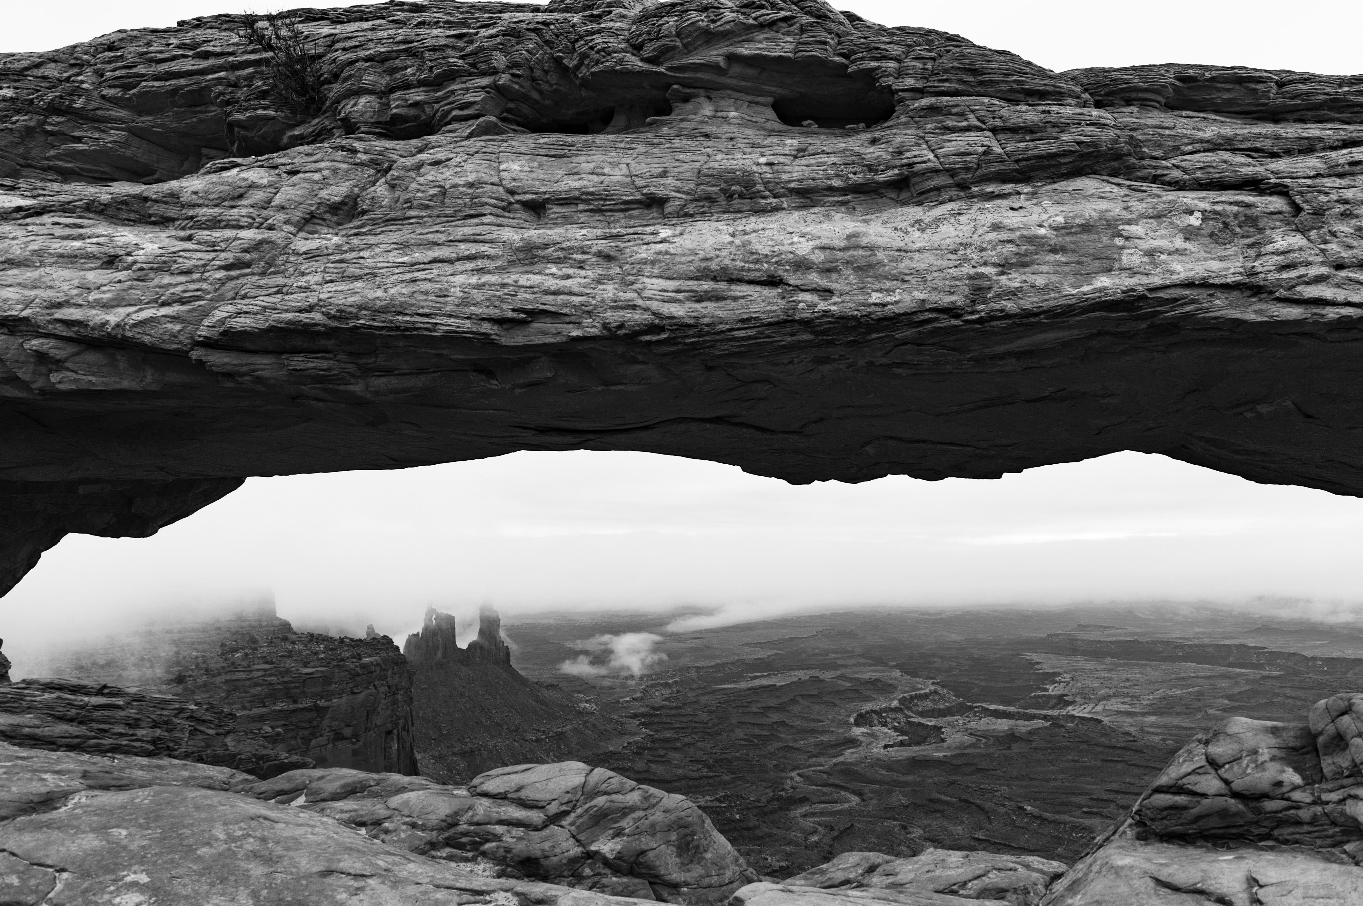
Training
Batches of 20 photos
Logistic Regression, FF NN, CNN trained for 5 epochs
ResNet trained for 25

Slide 8
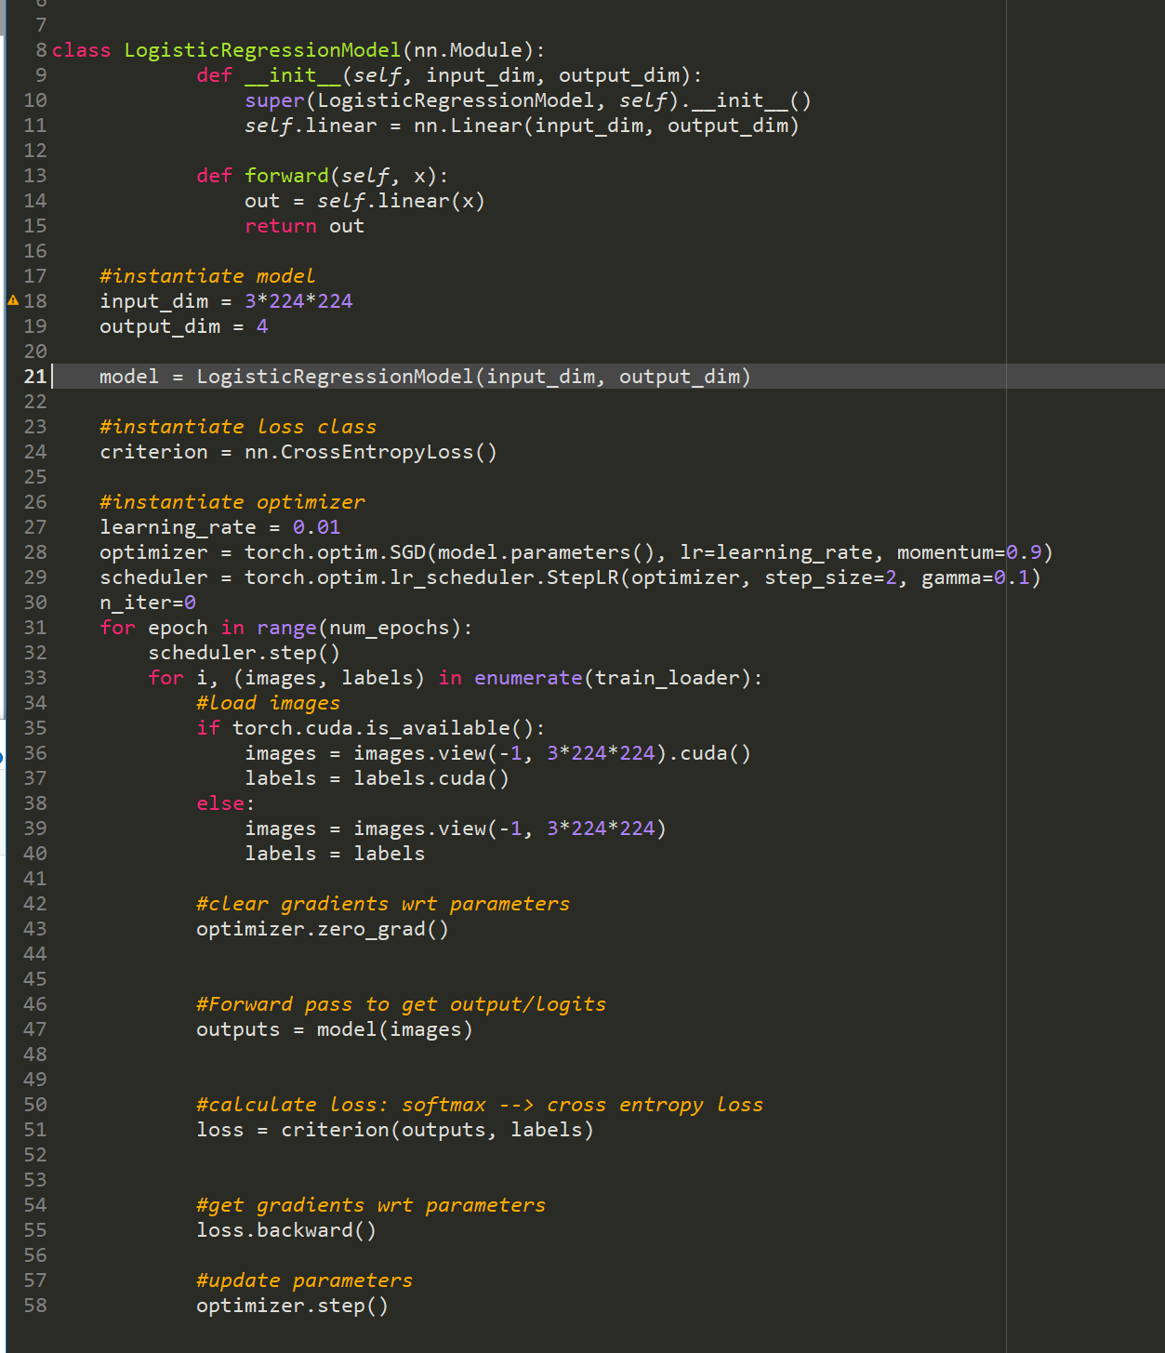
Logistic Regression
Input dimension (# of columns):
224x224x3 = 150,528
Output dimension:
4 – one for each category
Cross Entropy Loss is used to train as a logistic regression

Slide 9
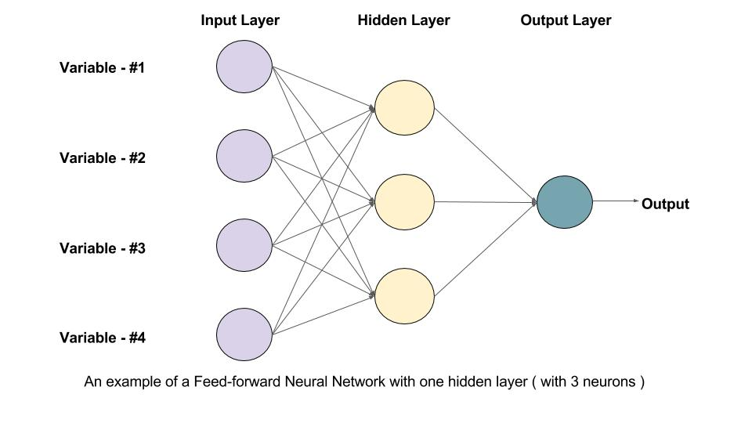
Feed Forward NN
Source: Learn OpenCV https://www.learnopencv.com/understanding-feedforward-neural-networks/

Slide 10
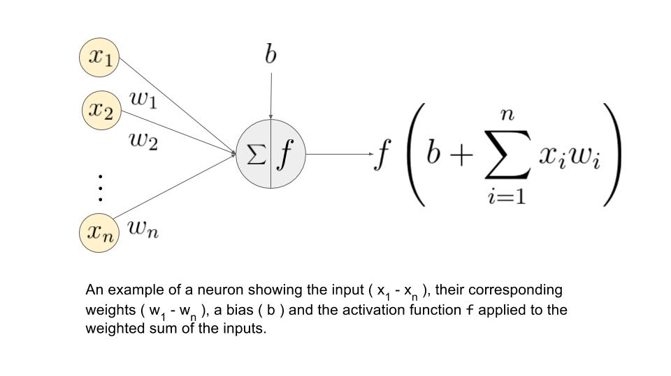
Feed Forward NN
Source: Learn OpenCV https://www.learnopencv.com/understanding-feedforward-neural-networks/

Slide 11
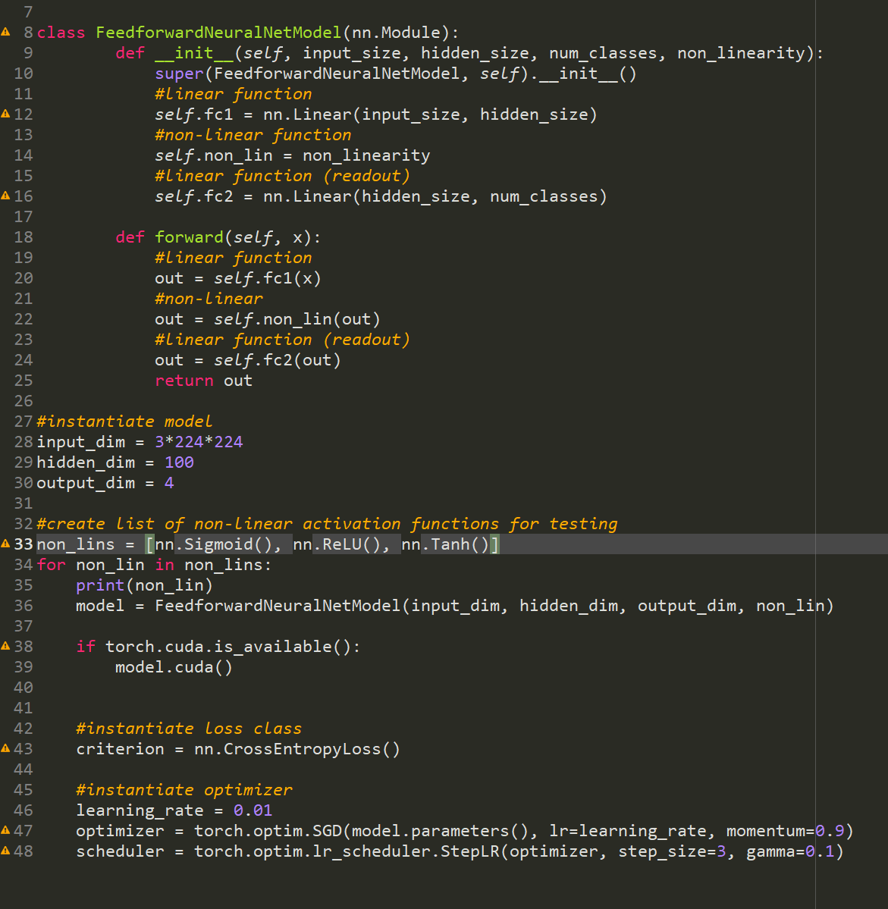
Feed Forward NN
Input dimension:
224x224x3 = 150,528
Hidden dimension:
100
Output dimension:
4
Sigmoid activation function

Slide 12

Convolutional Neural Network
Source: https://www.mathworks.com/videos/introduction-to-deep-learning-what-are-convolutional-neural-networks--1489512765771.html

Slide 13
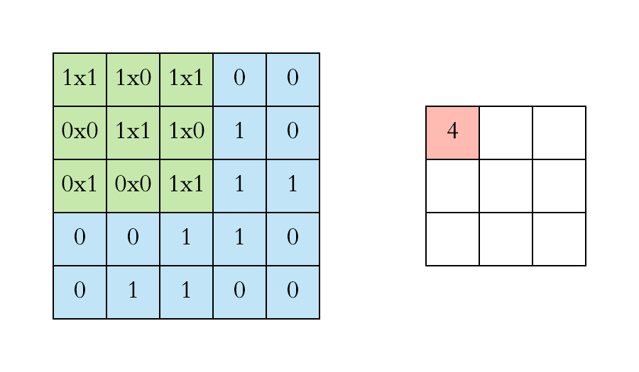
Convolution
Source: https://towardsdatascience.com/applied-deep-learning-part-4-convolutional-neural-networks-584bc134c1e2

Slide 14

Stride
Source: Free Code Camp https://medium.freecodecamp.org/an-intuitive-guide-to-convolutional-neural-networks-260c2de0a050

Slide 15
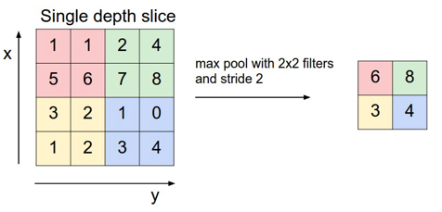
Pooling
Source: Free Code Camp https://medium.freecodecamp.org/an-intuitive-guide-to-convolutional-neural-networks-260c2de0a050

Slide 16
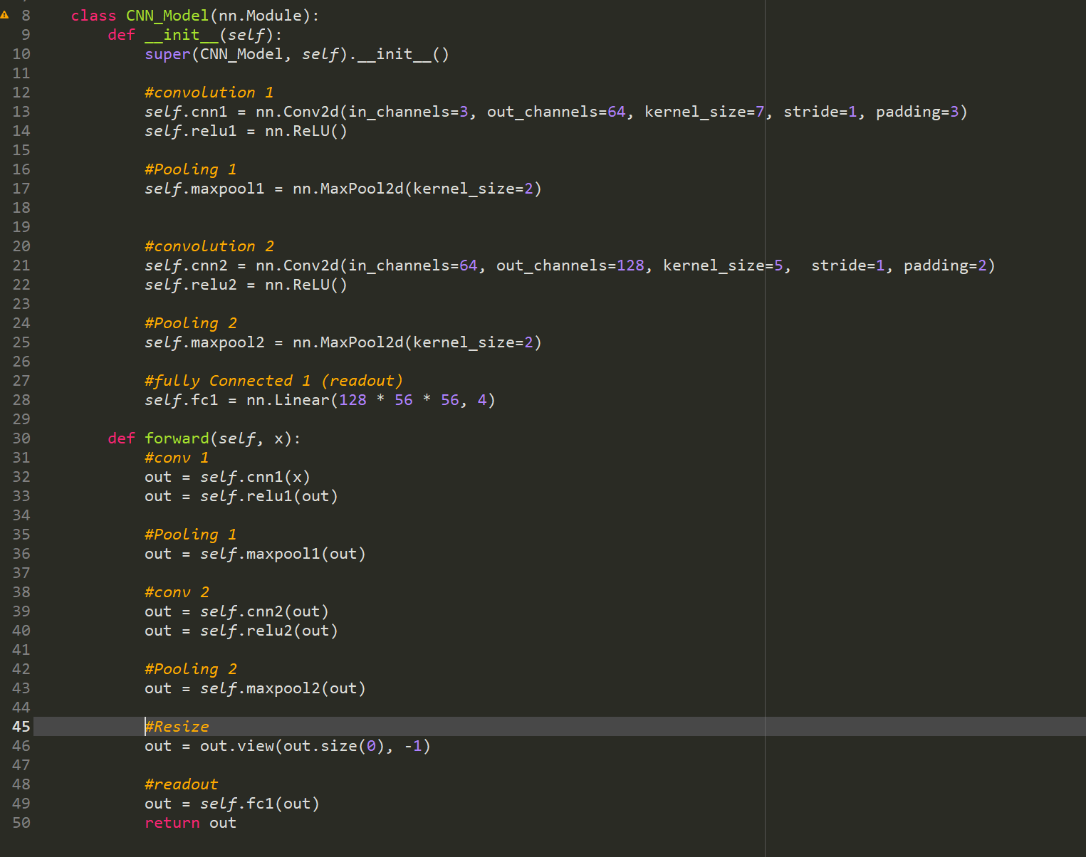
Simple CNN
2 convolutional layers
64 kernels, 7x7
128 kernels, 5x5
Max pooling
Input
3 x 224 x 224
Don’t need to flatten before hand

Slide 17
ResNet
Residual Network
Theorized to make training easier
Attempting to solve an issue where deeper networks actually have higher training error
Trained for the ImageNet Large Scale Visual Recognition Competition (ILSVRC)
1.28 million training images
50,000 validation images
1000 classes
Multiple versions with different depths
18, 34, 50, 101, 152 layers
An ensemble of these won 1st place in ILSVRC 2015 and COCO 2015
Source: He et al., 2015. Deep Residual Learning for Image Recognition

Slide 18
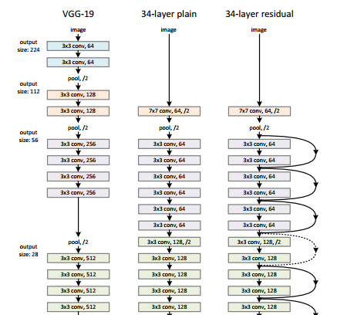
ResNet
Source: He et al., 2015. Deep Residual Learning for Image Recognition

Slide 19
Transfer Learning
Source: Learn OpenCV https://www.learnopencv.com/understanding-feedforward-neural-networks/

Slide 20
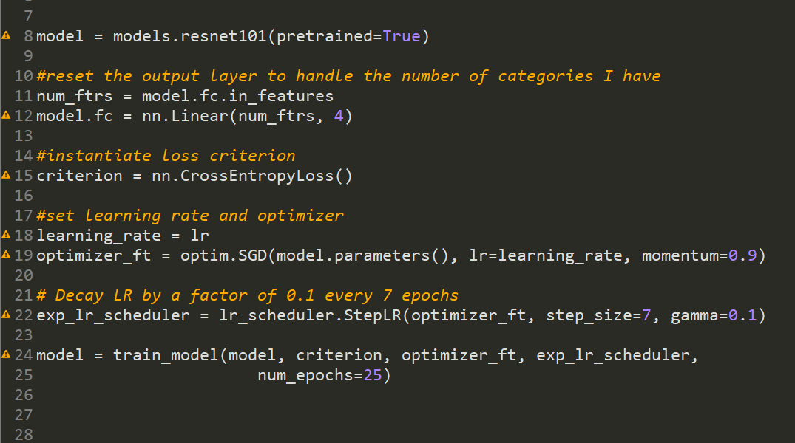
ResNet 101, Setting up for Transfer Learning

Slide 21
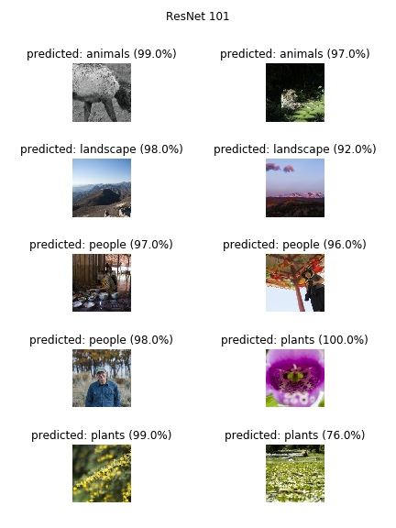
Model Performance
Logistic Regression
51.9% validation accuracy
7/10 final image accuracy
Feed-forward Neural Net
53.1% validation accuracy
6/10 final image accuracy
Simple CNN
62.5% validation accuracy
2/10 final image accuracy
ResNet101
98.1% validation accuracy
10/10 final image accuracy

Slide 22
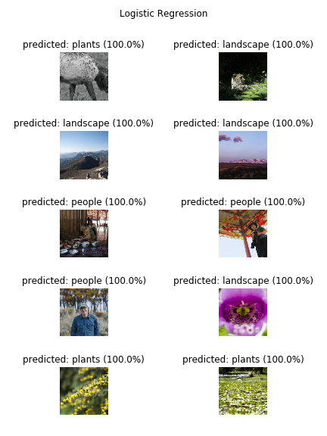
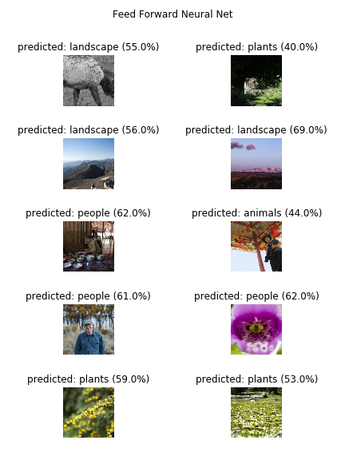
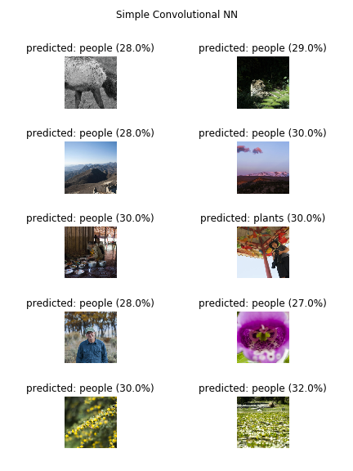

Slide 23
Conclusions
Very impressive accuracy for ResNet model
Very few relative training images
Could adapt easily to stock photography.
Don’t need a ton of images to add more categories
Can adapt model to get top n-categories
Useful for applying more than one tag to a photo

Slide 24
Git Repository
All code for this project can be found here:
https://github.com/Liptoni/Springboard/tree/master/Photo_Classification_Capstone

